Slide 1
Initialization and Regularization

Slide 2
Business
Lab 5b Tensorboard -- due tonight
Lab 6 Feature zoo 1 – due in one week

Slide 3
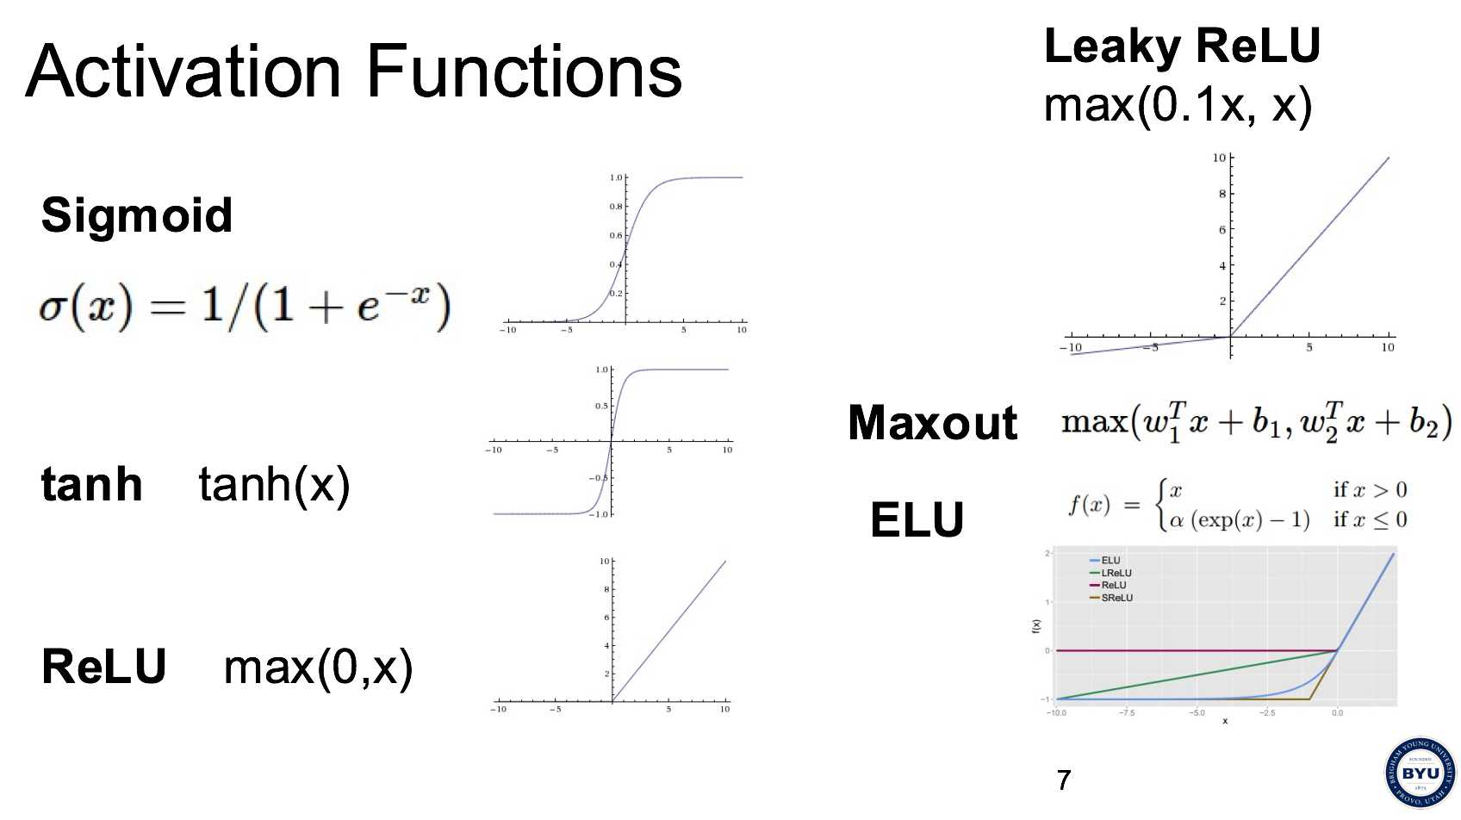
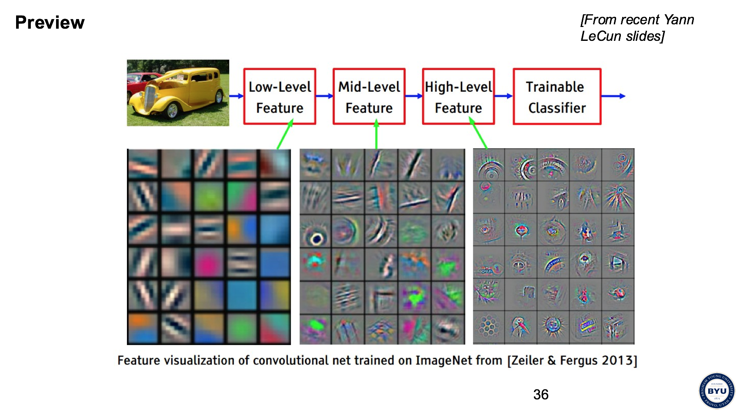
Last time
Activation functions
Convolutions

Slide 4
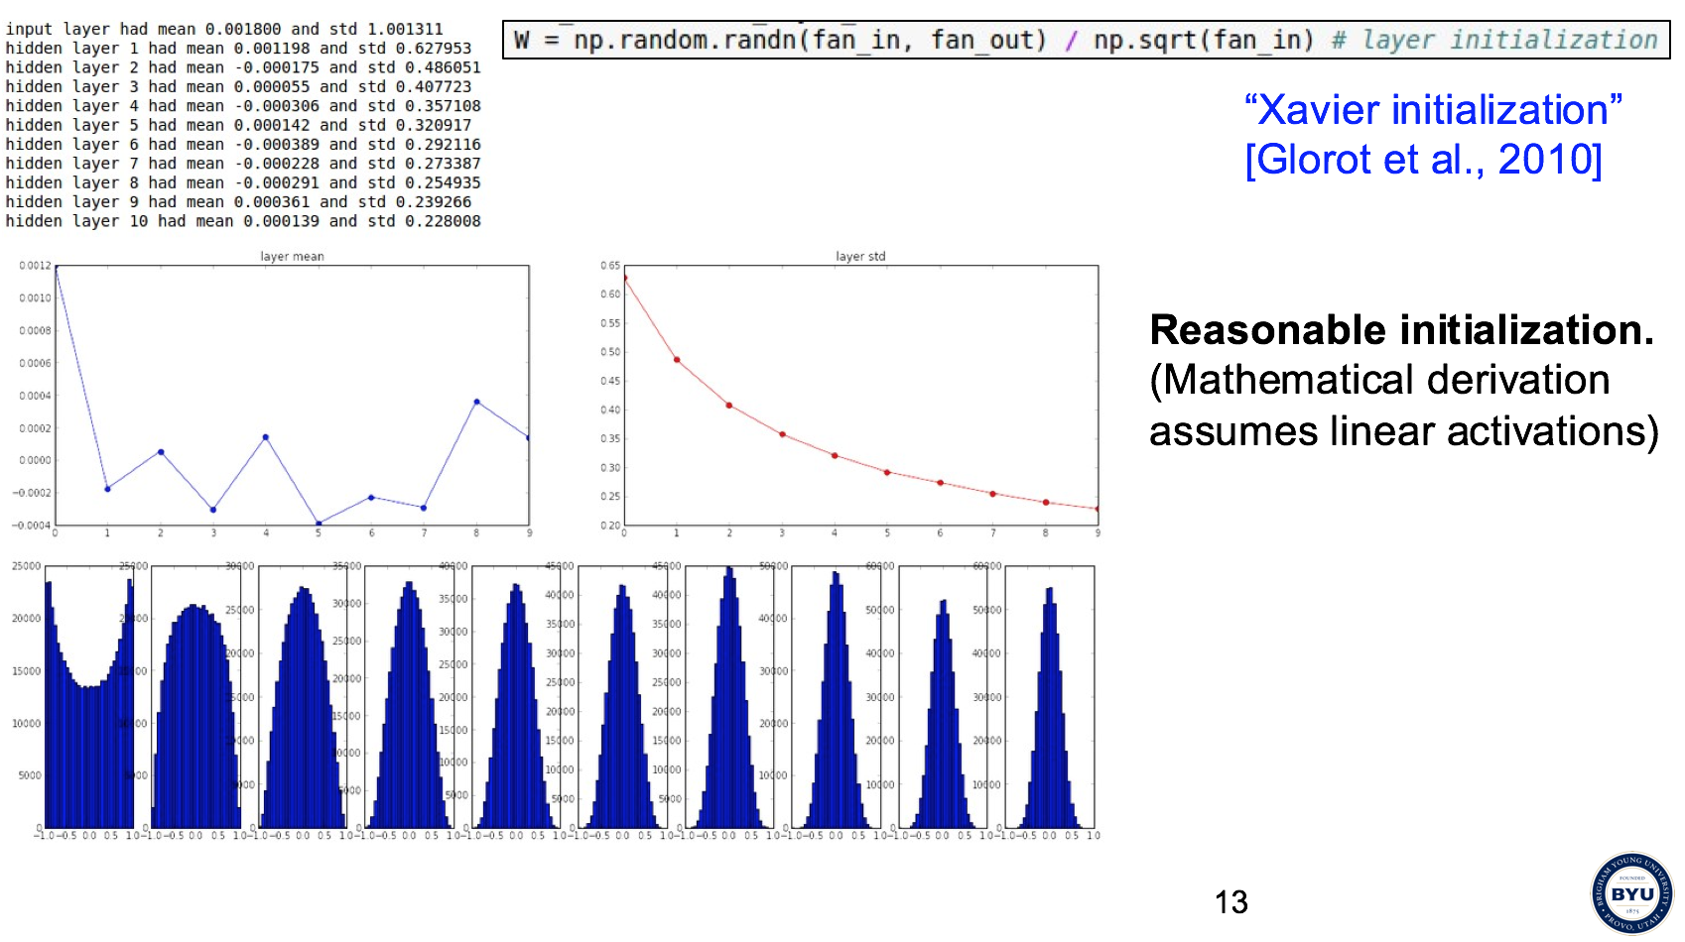
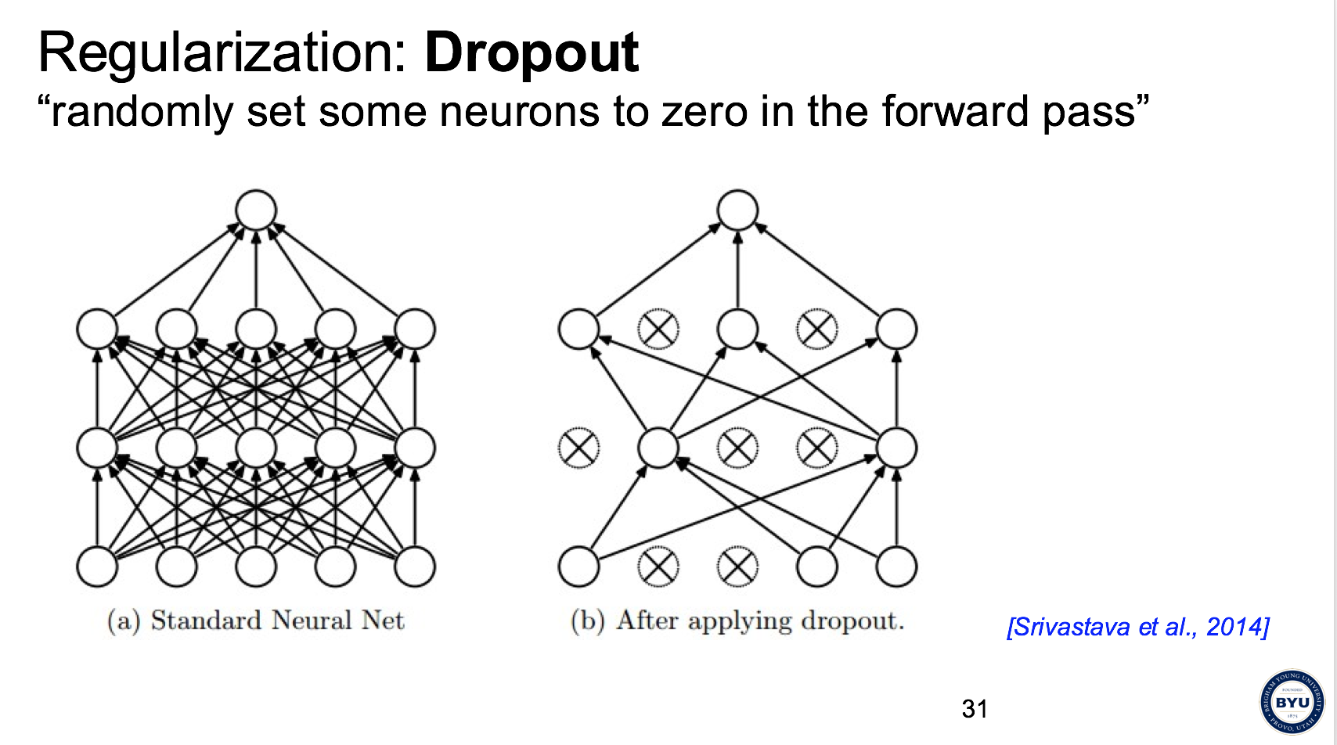
Today
Initialization
Regularization
L1, L2, Elastic net
Dropout and variants

Slide 5
Initialization

Slide 6

Q: what happens when W=0 init is used?

Slide 7
First idea: Small random numbers
(gaussian with zero mean and 1e-2 standard deviation)

Slide 8
First idea: Small random numbers
(gaussian with zero mean and 1e-2 standard deviation)
Works ~okay for small networks, but can lead to non-homogeneous distributions of activations across the layers of a network.

Slide 9
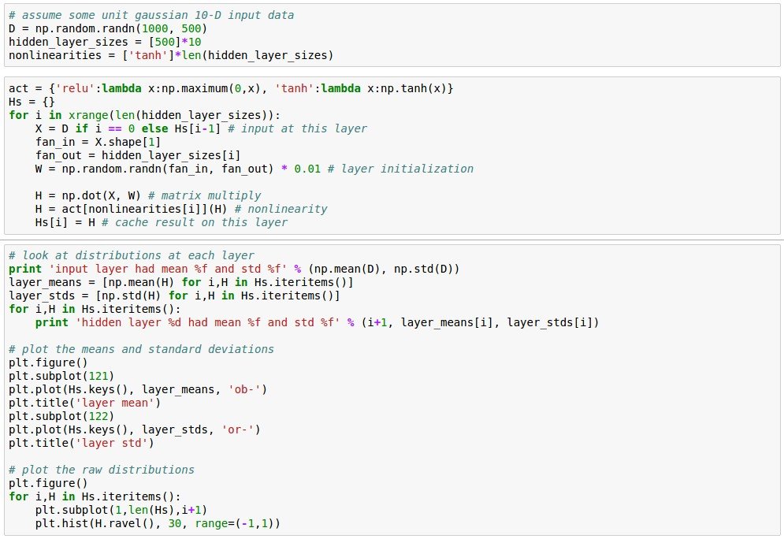
Lets look at some activation statistics
E.g. 10-layer net with 500 neurons on each layer, using tanh non-linearities, and initializing as described in last slide.

Slide 10
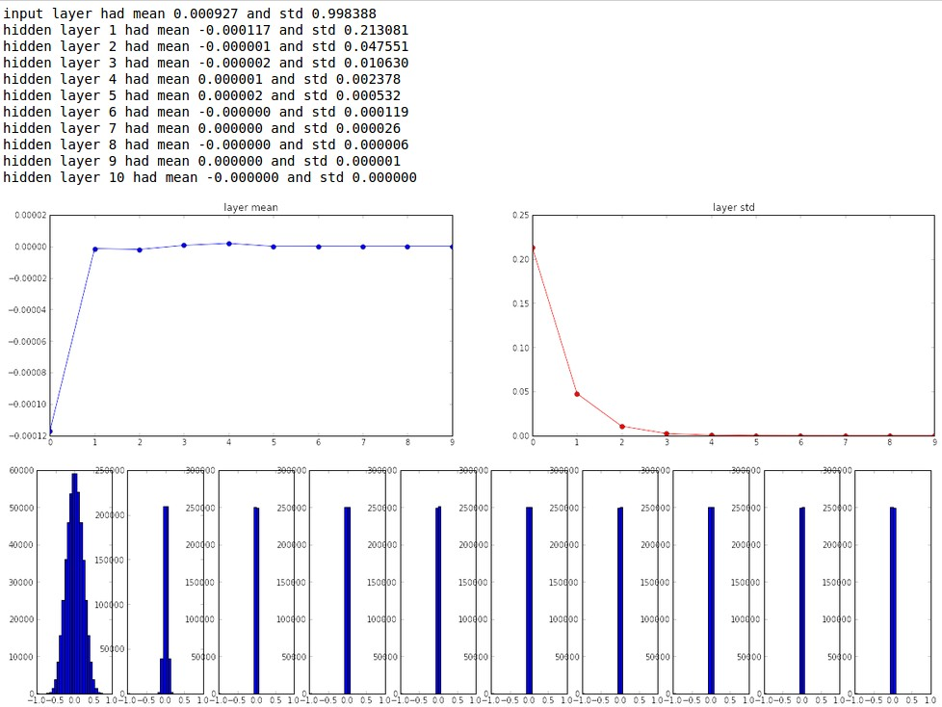

Slide 11
All activations become zero!
Q: think about the backward pass. What do the gradients look like?
Hint: think about backward pass for a W*X gate.

Slide 12
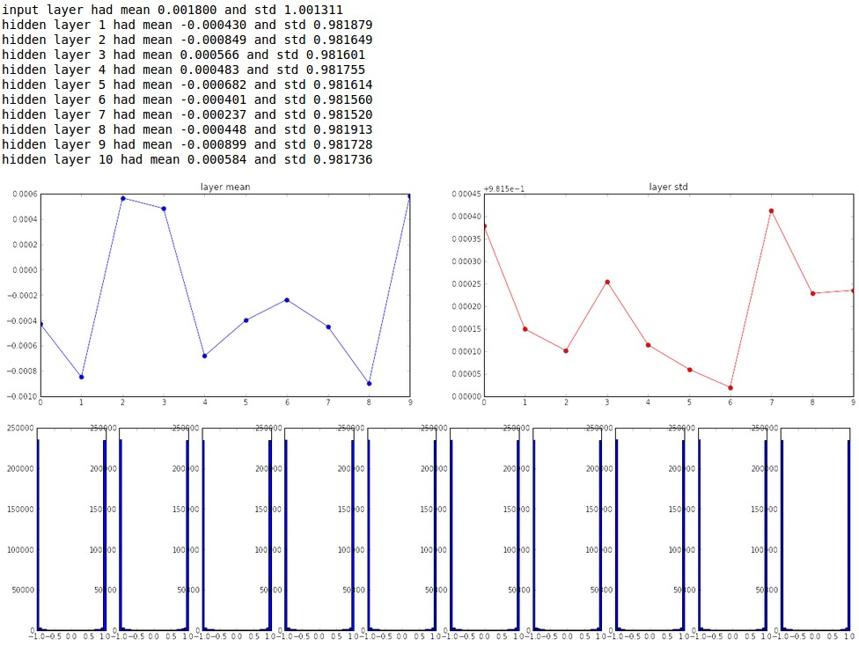
Almost all neurons completely saturated, either -1 and 1. Gradients will be all zero.
*1.0 instead of *0.01

Slide 13
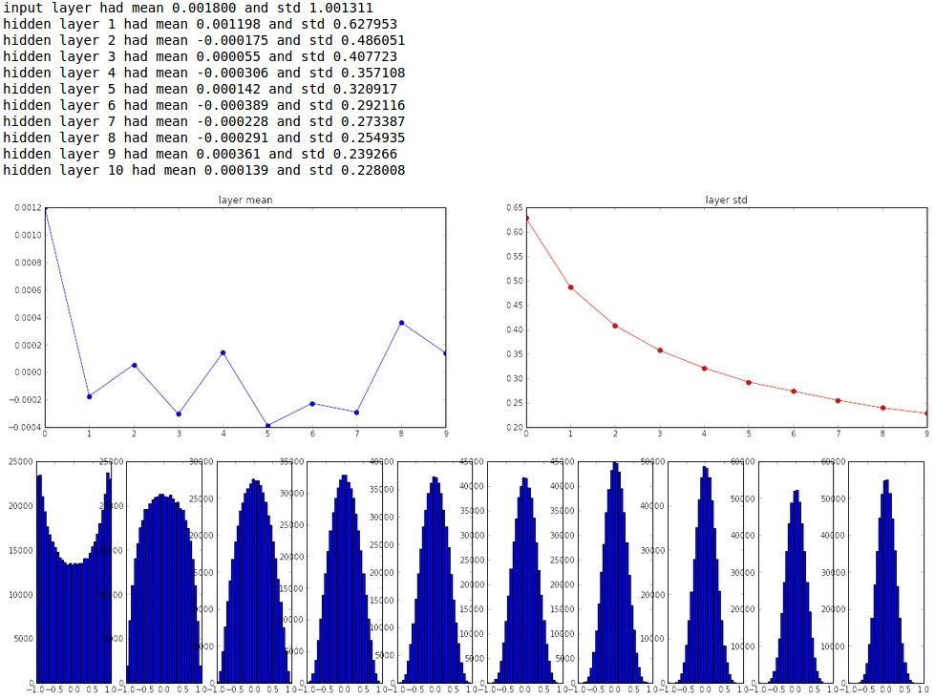
“Xavier initialization”
[Glorot et al., 2010]
Reasonable initialization.
(Mathematical derivation assumes linear activations)

Slide 14
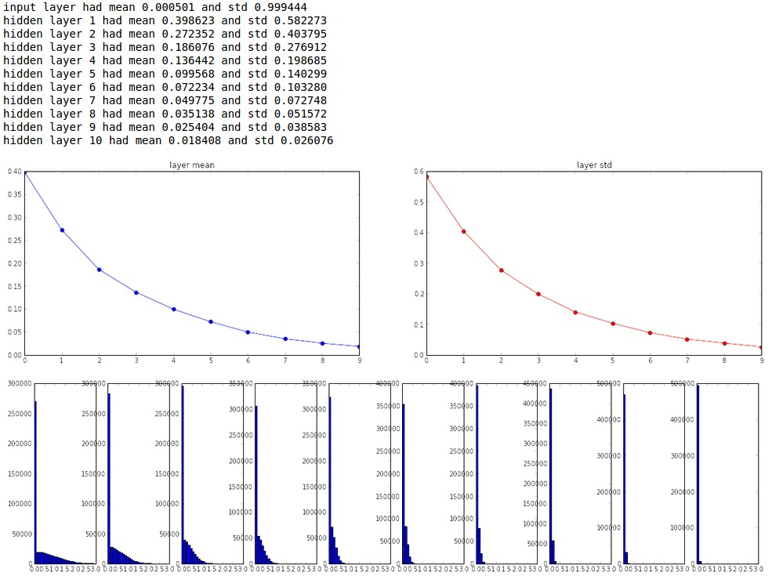
but when using the ReLU nonlinearity it breaks.

Slide 15
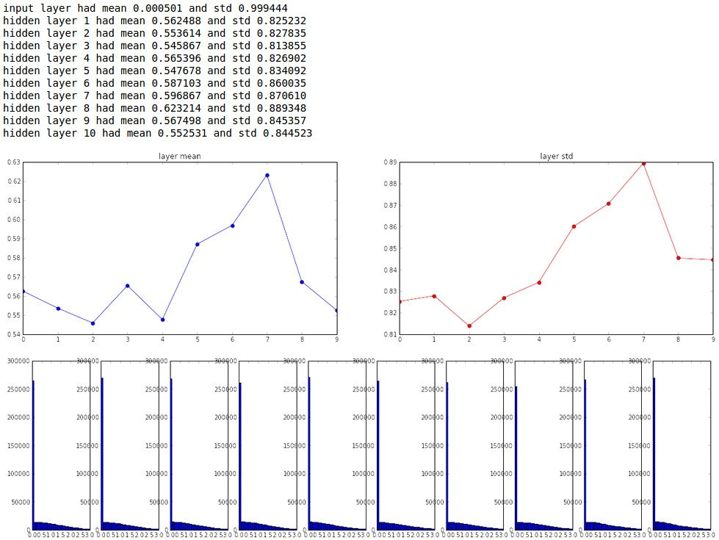
He et al., 2015
(note additional /2)

Slide 16
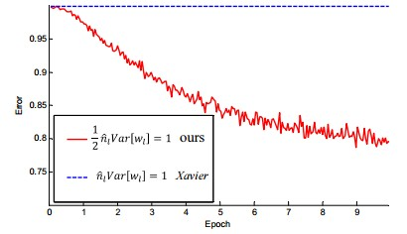
He et al., 2015
(note additional /2)

Slide 17
Proper initialization is an active area of research…
Understanding the difficulty of training deep feedforward neural networks
by Glorot and Bengio, 2010
Exact solutions to the nonlinear dynamics of learning in deep linear neural networks by Saxe et al, 2013
Random walk initialization for training very deep feedforward networks by Sussillo and Abbott, 2014
Delving deep into rectifiers: Surpassing human-level performance on ImageNet classification by He et al., 2015
Data-dependent Initializations of Convolutional Neural Networks by Krähenbühl et al., 2015
All you need is a good init, Mishkin and Matas, 2015
…

Slide 18
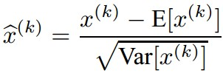
Batch Normalization
[Ioffe and Szegedy, 2015]
“you want unit gaussian activations? just make them so.”
consider a batch of activations at some layer. To make each dimension unit gaussian, apply:
this is a vanilla differentiable function...

Slide 19
Batch Normalization
[Ioffe and Szegedy, 2015]
“you want unit gaussian activations?
just make them so.”
1. compute the empirical mean and variance independently for each dimension.
X
N
2. Normalize
D

Slide 20
Batch Normalization
[Ioffe and Szegedy, 2015]
FC
Usually inserted after Fully Connected / (or Convolutional, as we’ll see soon) layers, and before nonlinearity.
BN
tanh
FC
Problem: do we necessarily want a unit gaussian input to a tanh layer?
BN
tanh
...

Slide 21
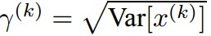
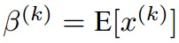
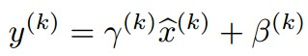
Batch Normalization
[Ioffe and Szegedy, 2015]
Normalize:
Note, the network can learn:
And then allow the network to squash
the range if it wants to:
to recover the identity mapping.

Slide 22
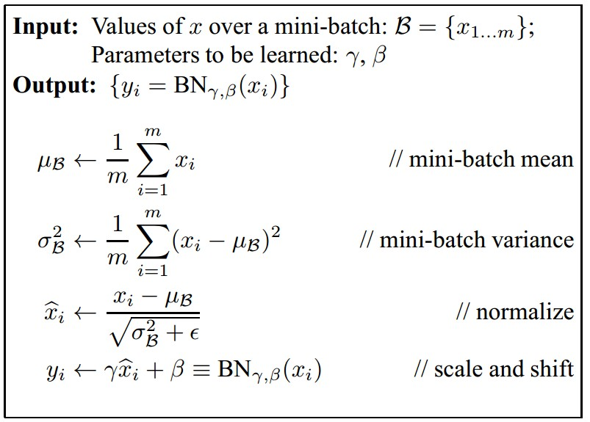
Batch Normalization
[Ioffe and Szegedy, 2015]
Improves gradient flow through the network
Allows higher learning rates
Reduces the strong dependence on initialization
Acts as a form of regularization in a funny way, and slightly reduces the need for dropout, maybe

Slide 23
Batch Normalization
[Ioffe and Szegedy, 2015]
Note: at test time BatchNorm layer functions differently:
The mean/std are not computed based on the batch. Instead, a single fixed empirical mean of activations during training is used.
(e.g. can be estimated during training with running averages)

Slide 24
Basic regularization

Slide 25
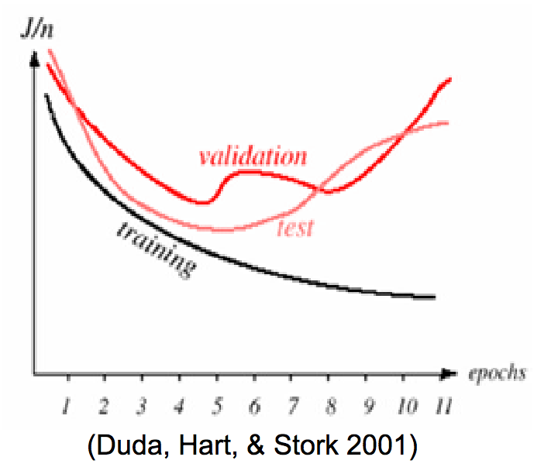
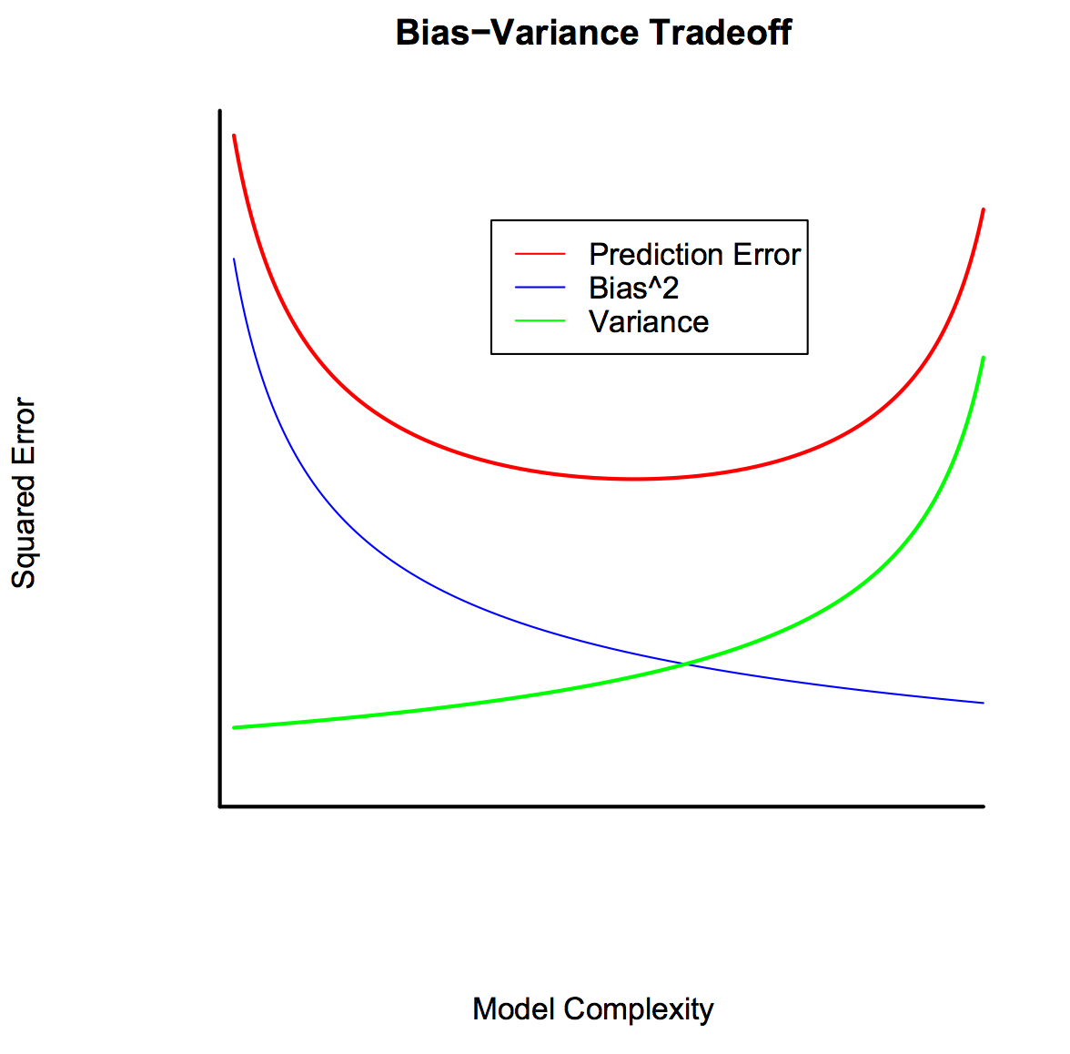
Regularization themes
Reduces overfitting by favoring “simpler” models
Bias-variance trade-off
Some equivalence to Bayesian MAP estimation
Some regularizers encourage sparsity (known as “sparsity-encouraging”)

Slide 26
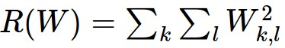
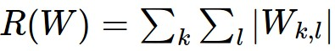
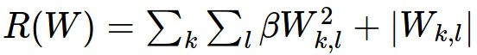
Weight Regularization
\lambda = regularization strength
(hyperparameter)
In common use:
L2 regularization
L1 regularization
Elastic net (L1 + L2)

Slide 27
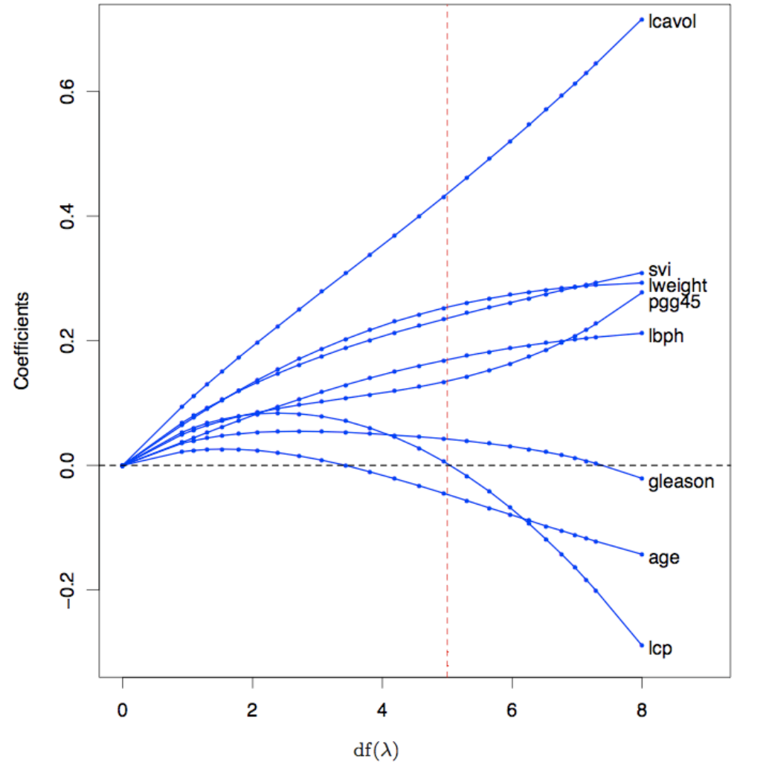
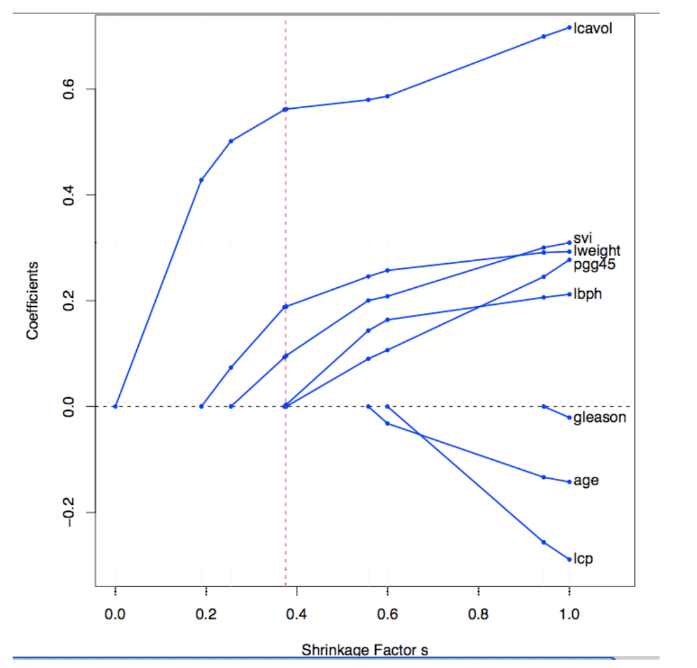
Regularization regression on diabetes dataset
L2 regularization
L1 regularization
From Hastie et al, Fig. 3.8 and 3.10

Slide 28
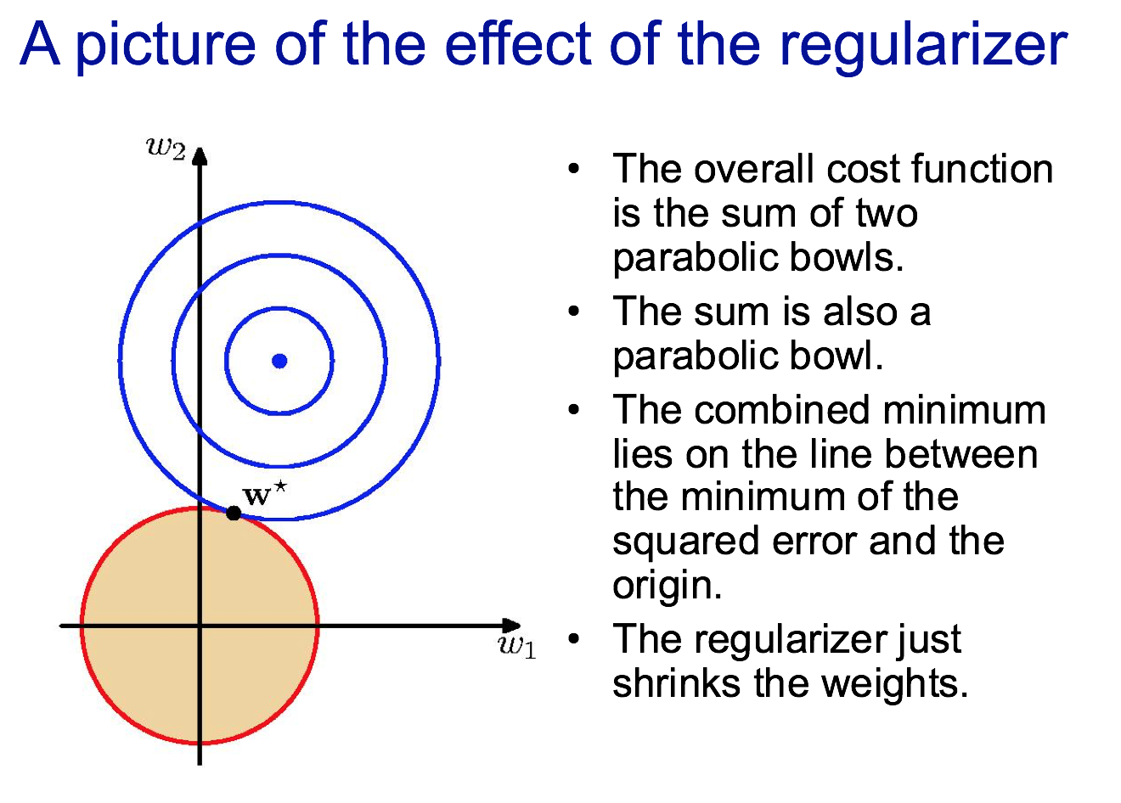
Slide credit: Geoff Hinton, CSC2515

Slide 30
DNN-style regularization

Slide 31
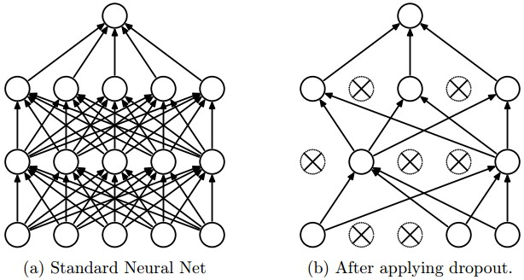
Regularization: Dropout
“randomly set some neurons to zero in the forward pass”
[Srivastava et al., 2014]

Slide 32
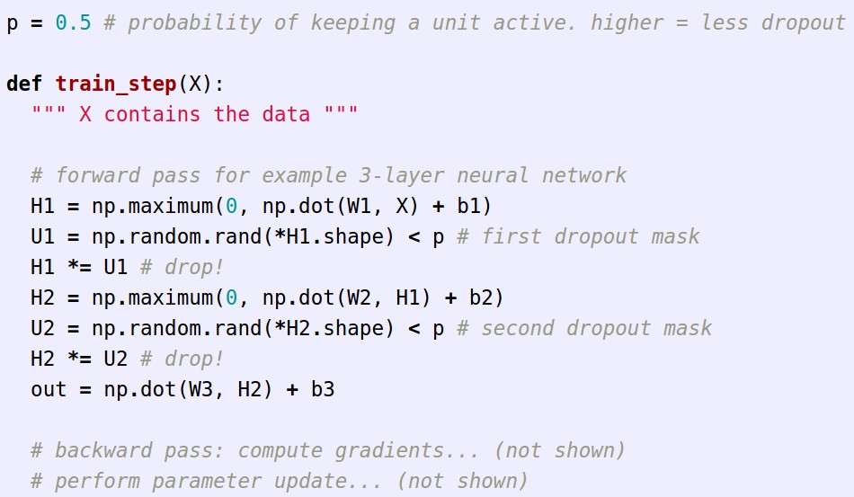
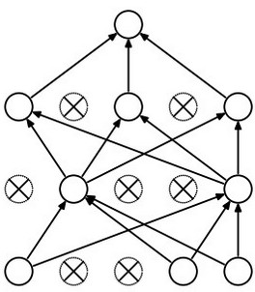
Example forward pass with a 3-layer network using dropout

Slide 33
Waaaait a second…
How could this possibly be a good idea?

Slide 34
Waaaait a second…
How could this possibly be a good idea?
Forces the network to have a redundant representation.
has an ear
X
has a tail
is furry
X
cat
score
has claws
X
mischievous
look

Slide 35
Waaaait a second…
How could this possibly be a good idea?
Another interpretation:
Dropout is training a large ensemble of models (that share parameters).
Each binary mask is one model, gets trained on only ~one datapoint.

Slide 36
Another interpretation: adaptive regularization
“Dropout training falls into the broader category of learning methods that artificially corrupt training data to stabilize predictions… the effect of training with features that have been corrupted with additive Gaussian noise is equivalent to a form of L2-type regularization in the low noise limit…
We show that dropout training is first-order equivalent to L2-regularization after transforming the input by diag(Iˆ)"1/2, where Iˆ is an estimate of the Fisher information matrix.
This transformation effectively makes the level curves of the objective more spherical, and so balances out the regularization applied to different features. In the case of logistic regression, dropout can be interpreted as a form of adaptive L2-regularization that favors rare but useful features.”
Wager, Lang, Liang, NIPS 2013

Slide 37
At test time….
Ideally:
want to integrate out all the noise
Monte Carlo approximation:
do many forward passes with different dropout masks, average all predictions

Slide 38
At test time….
Can in fact do this with a single forward pass! (approximately)
Leave all input neurons turned on (no dropout).
(this can be shown to be an approximation to evaluating the whole ensemble)

Slide 39
At test time….
Can in fact do this with a single forward pass! (approximately)
Leave all input neurons turned on (no dropout).
Q: Suppose that with all inputs present at test time the output of this neuron is x.
What would its output be during training time, in expectation? (e.g. if p = 0.5)

Slide 40
At test time….
Can in fact do this with a single forward pass! (approximately)
Leave all input neurons turned on (no dropout).
during test: a = w0*x + w1*y
during train:
E[a] = ¼ * (w0*0 + w1*0
w0*0 + w1*y
w0*x + w1*0
w0*x + w1*y)
= ¼ * (2 w0*x + 2 w1*y)
= ½ * (w0*x + w1*y)
a
w1
w0
x
y

Slide 41
At test time….
Can in fact do this with a single forward pass! (approximately)
Leave all input neurons turned on (no dropout).
during test: a = w0*x + w1*y
during train:
E[a] = ¼ * (w0*0 + w1*0
w0*0 + w1*y
w0*x + w1*0
w0*x + w1*y)
= ¼ * (2 w0*x + 2 w1*y)
= ½ * (w0*x + w1*y)
With p=0.5, using all inputs in the forward pass would inflate the activations by 2x from what the network was “used to” during training!
=> Have to compensate by scaling the activations back down by ½
a
w1
w0
x
y

Slide 42
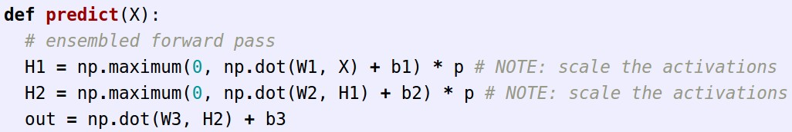
We can do something approximate analytically
At test time all neurons are active always
=> We must scale the activations so that for each neuron:
output at test time = expected output at training time

Slide 43
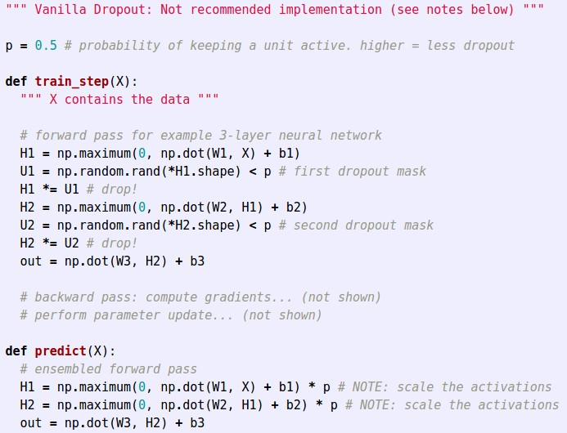
Dropout Summary
drop in forward pass
scale at test time

Slide 44
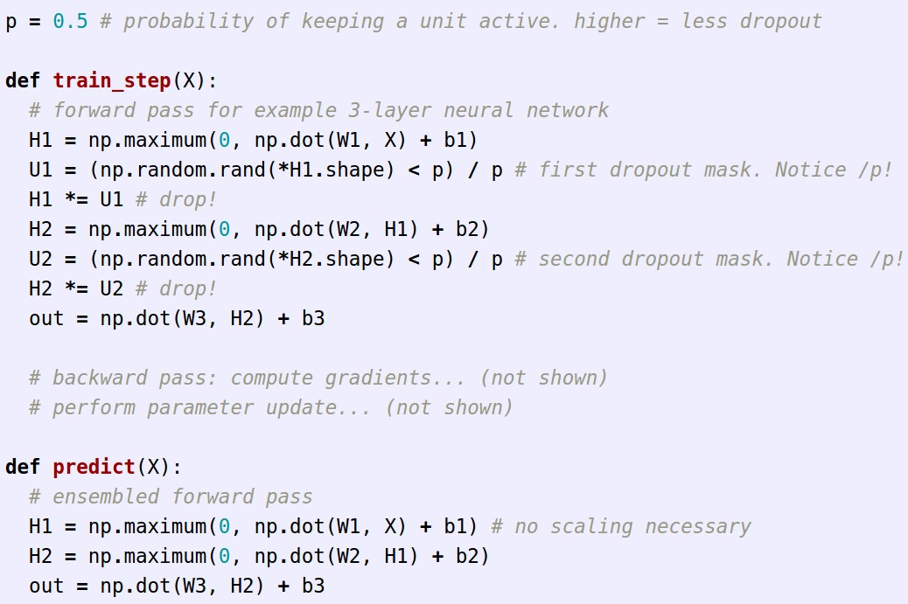
More common: “Inverted dropout”
test time is unchanged!

Slide 45
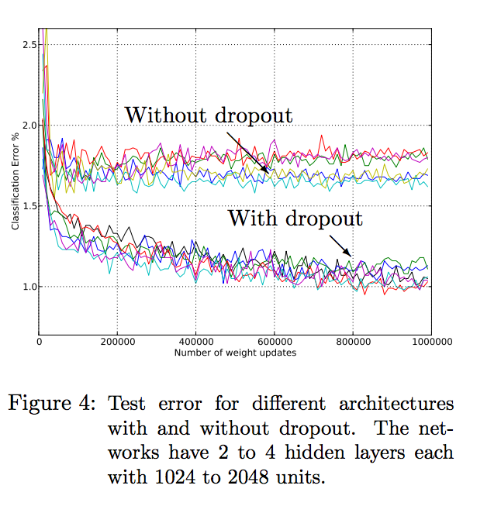
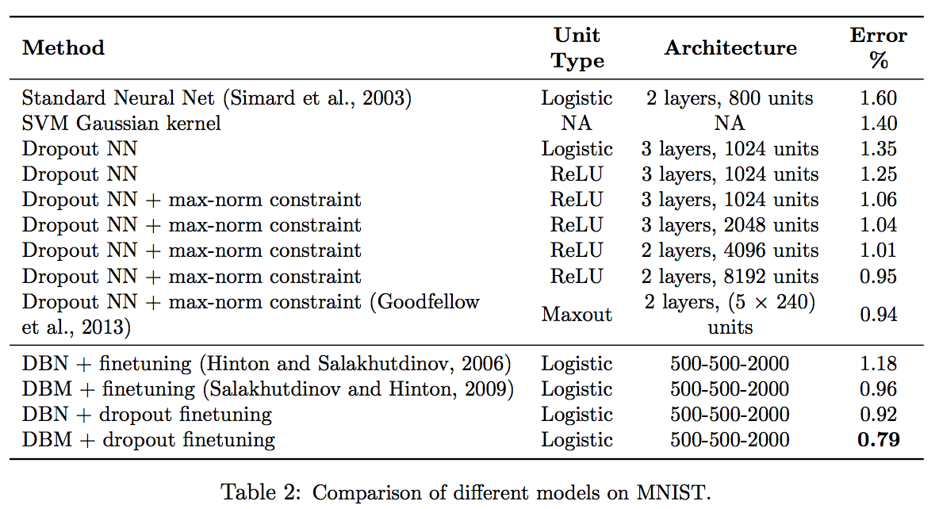
Srivastava et al, JMLR 2014

Slide 46
Variants

Slide 47
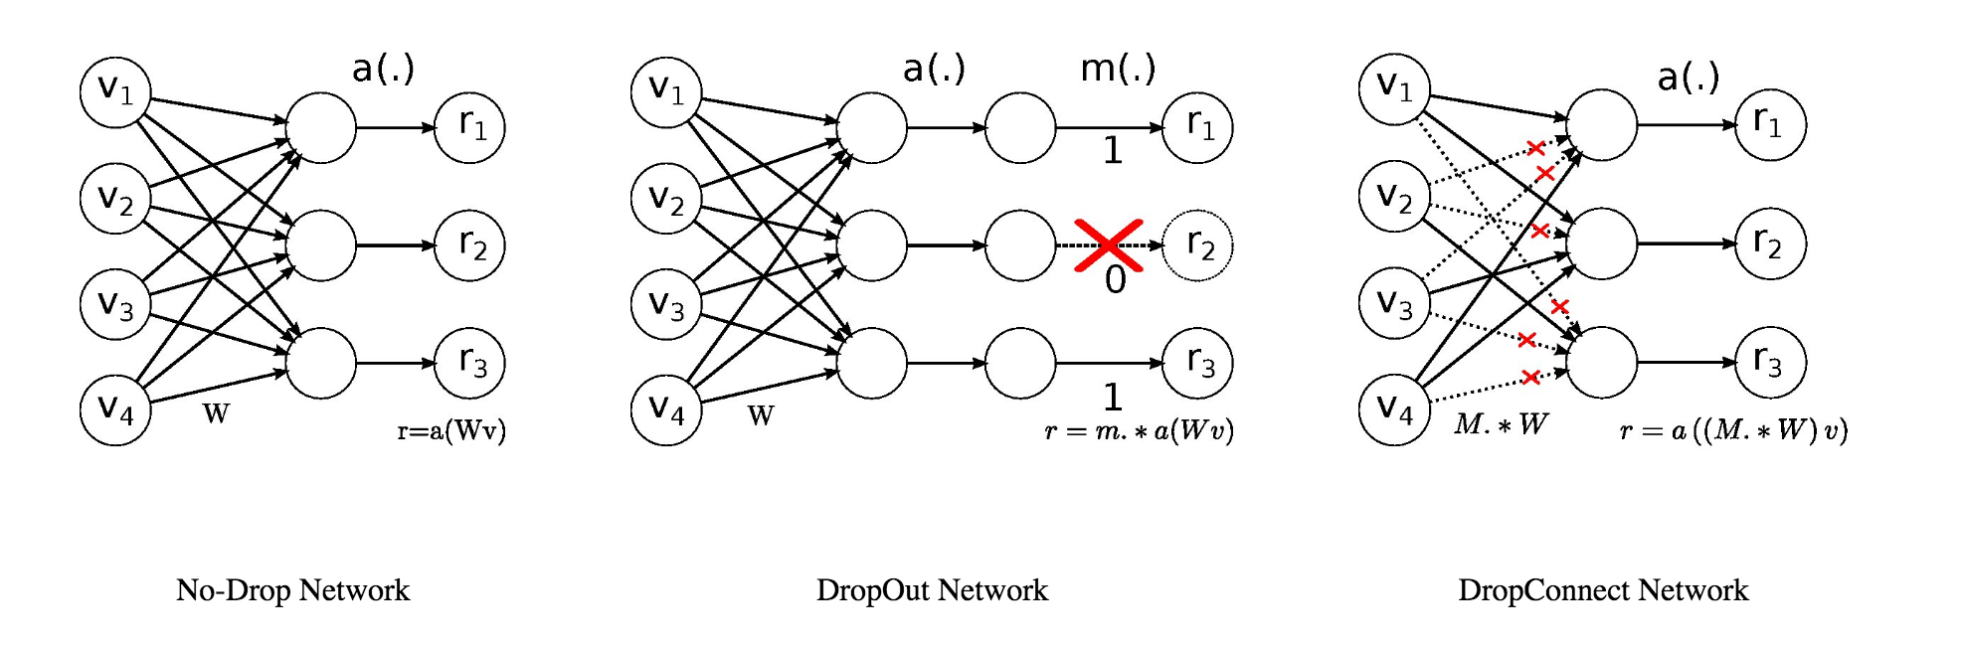
Dropconnect
Wan et al, ICML 2013

Slide 48
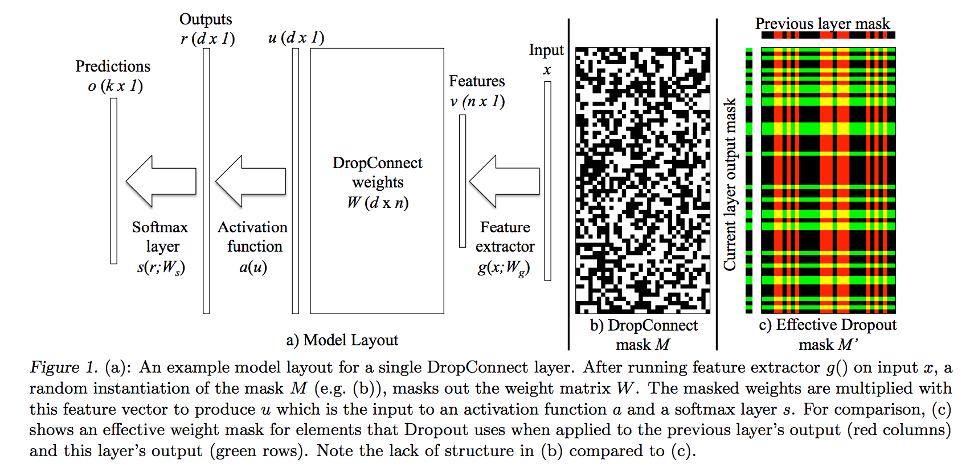

Slide 49
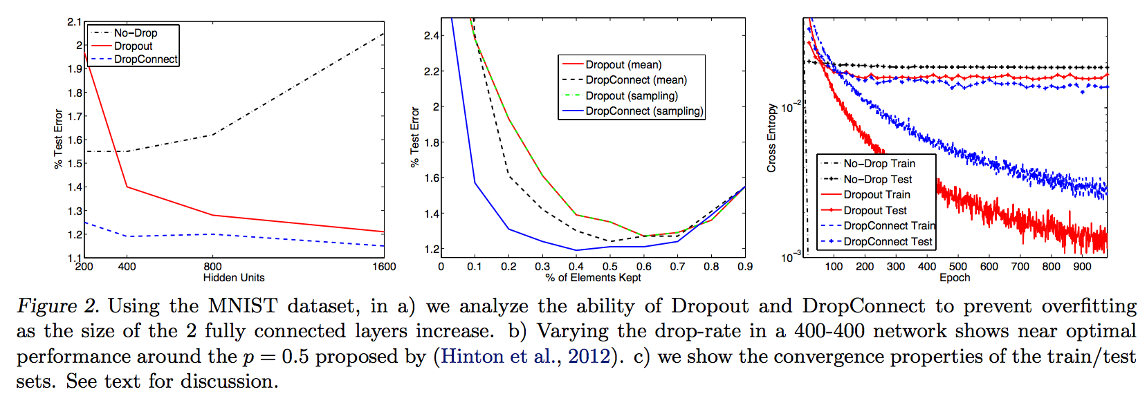

Slide 50
Why does this work?
“The important result from Eqn. 5 is that the complexity is a linear function of the probability p of an element being kept in DropConnect or Dropout. When p = 0, the model complexity is zero, since the input has no influence on the output. When p = 1, it returns to the complexity of a standard model.”

Slide 51
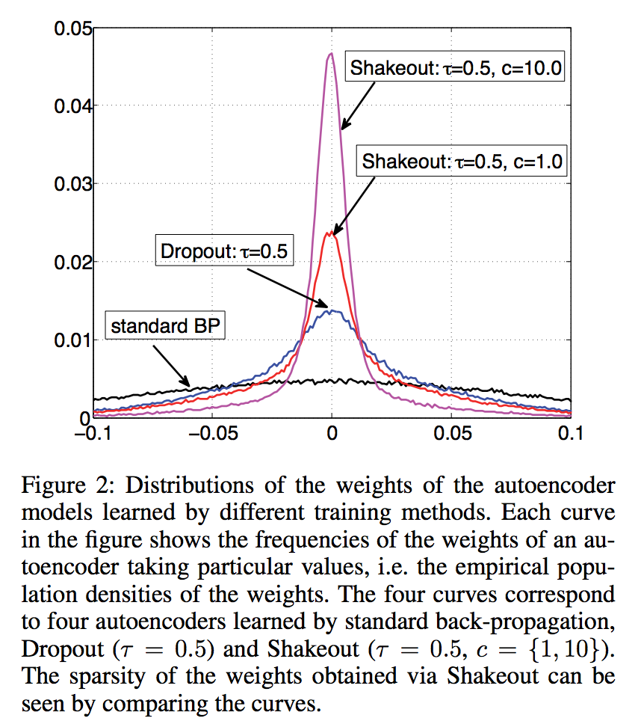
“Shakeout”
“Instead of randomly discarding units as Dropout does at the training stage, our method randomly chooses to enhance or inverse the contributions of each unit to the next layer. These operations can lead to a profound change to the regularization effect.
We have proved that the new training scheme imposes a combination of L1 regularization and L2 regularization on the weights of the model. We call our scheme “Shakeout” because of the randomly “shaking” process and the L1 regularization effect pushing network weights to zero.”
Claims:
- Effectively implements Elastic Net regularization
- Leads to increased model sparsity

Slide 52
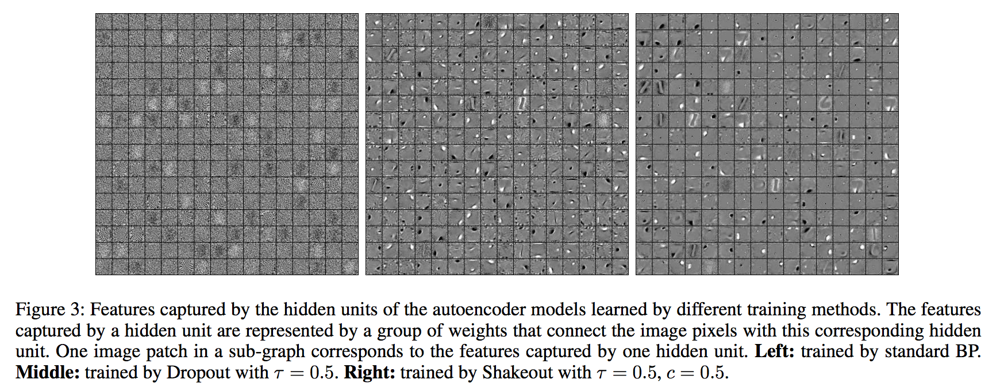
“Shakeout”

Slide 53
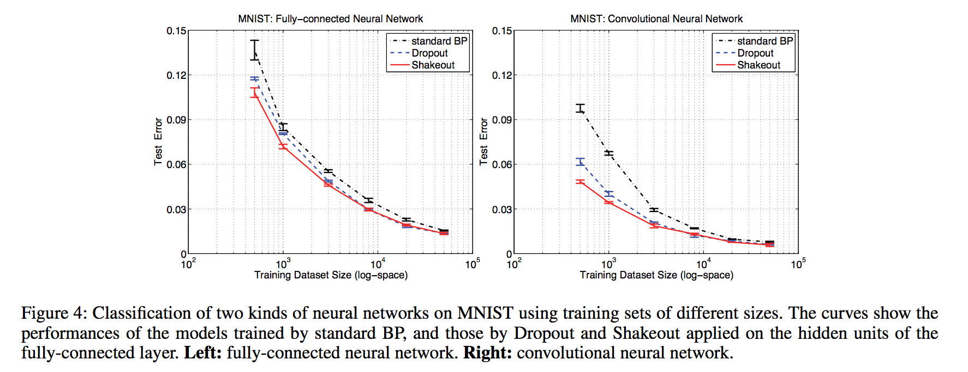
“Shakeout”

Slide 54
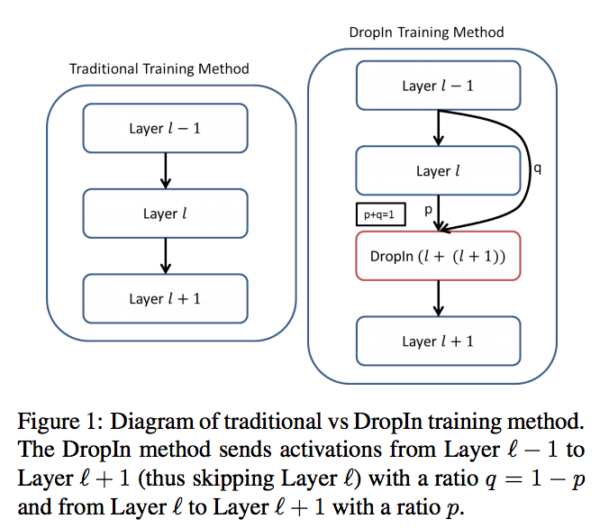
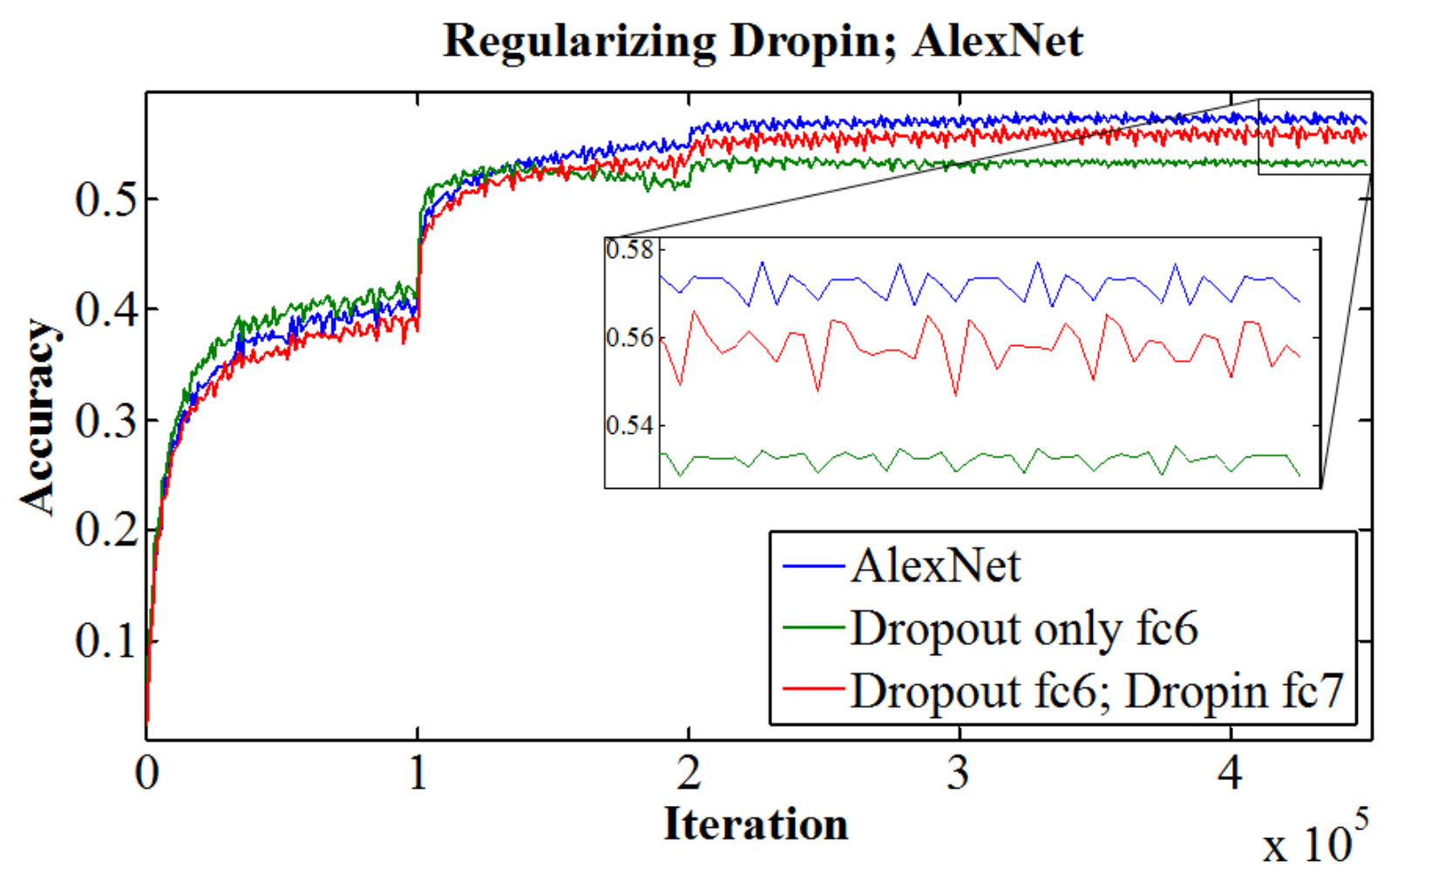
”DropIn”
Smith et al, CVPR 2016
“We introduce the concept of dynamically growing a neural network during training. In particular, an untrainable deep network starts as a trainable shallow network and newly added layers are slowly, organically added during training, thereby increasing the network’s depth.
DropIn can be used in a mode analogous to dropout [20] for the regularization of a deep neural network during training. Instead of setting random activations to zero, as is done in dropout, DropIn sets these activations to the activations from a previous layer.

Slide 55
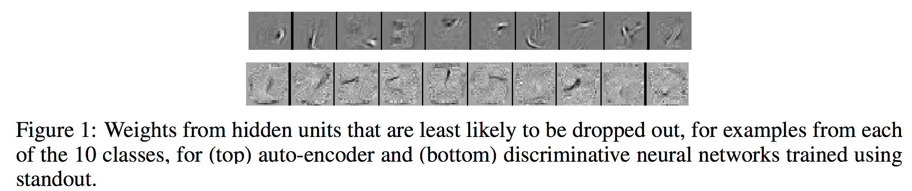
Adaptive dropout – “standout”
“We describe a method called ‘standout’ in which a binary belief network is overlaid on a neural network and is used to regularize of its hidden units by selectively setting activities to zero. This ‘adaptive dropout network’ can be trained jointly with the neural network by approximately computing local expectations of binary dropout variables, computing derivatives using back-propagation, and using stochastic gradient descent.
Ba and Frey, NIPS

